Slide 1
Founders Day Challenge Prizes

Slide 2
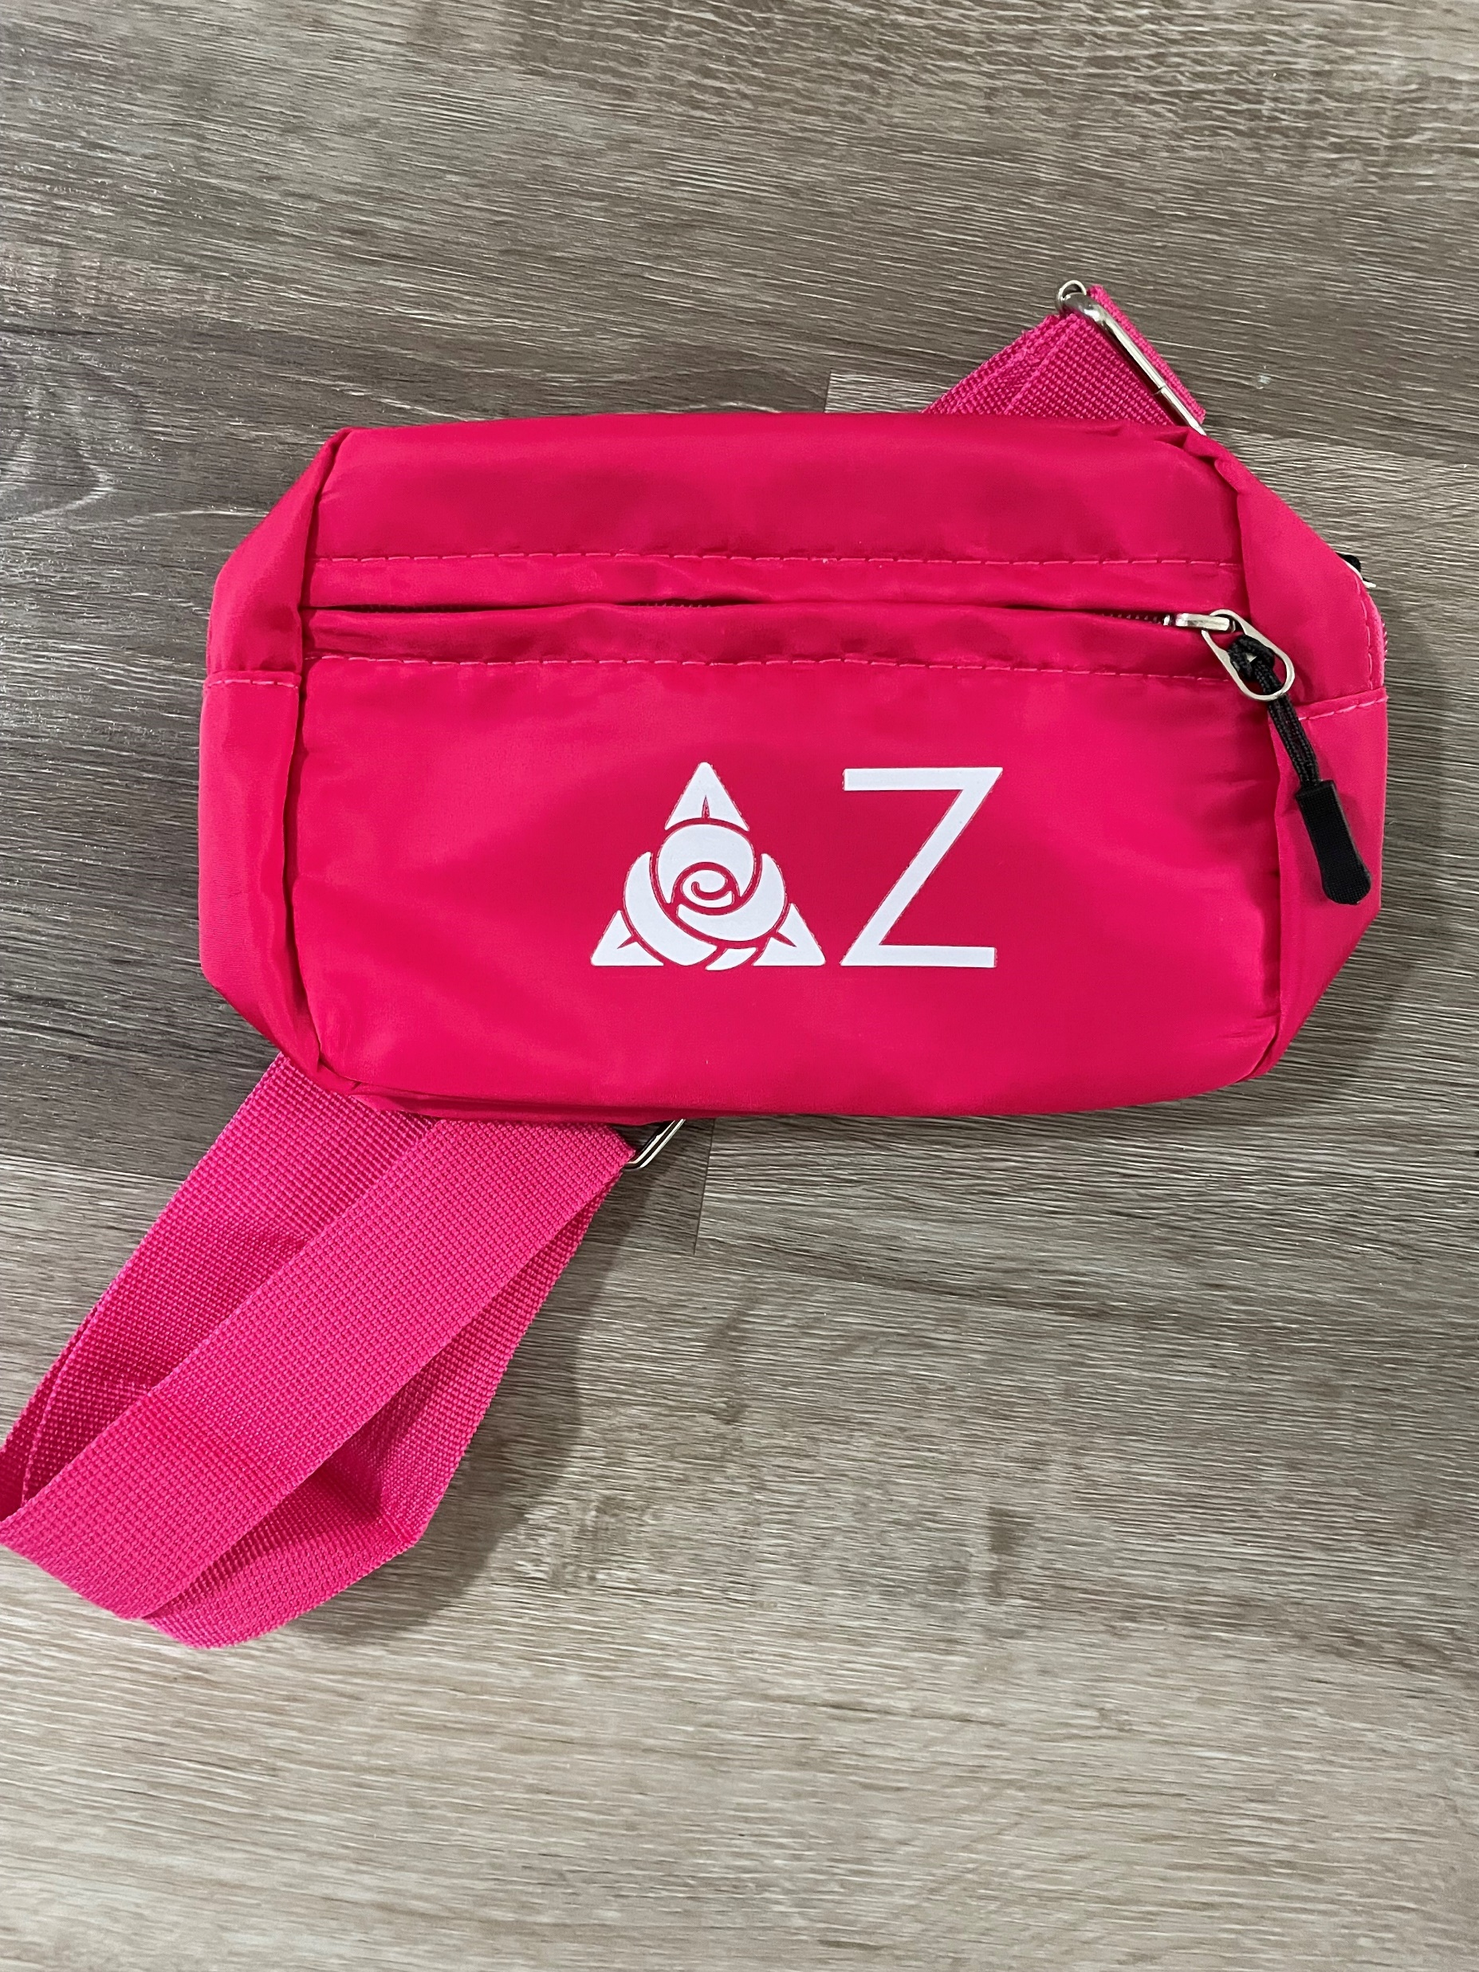
$250
$500

Slide 3
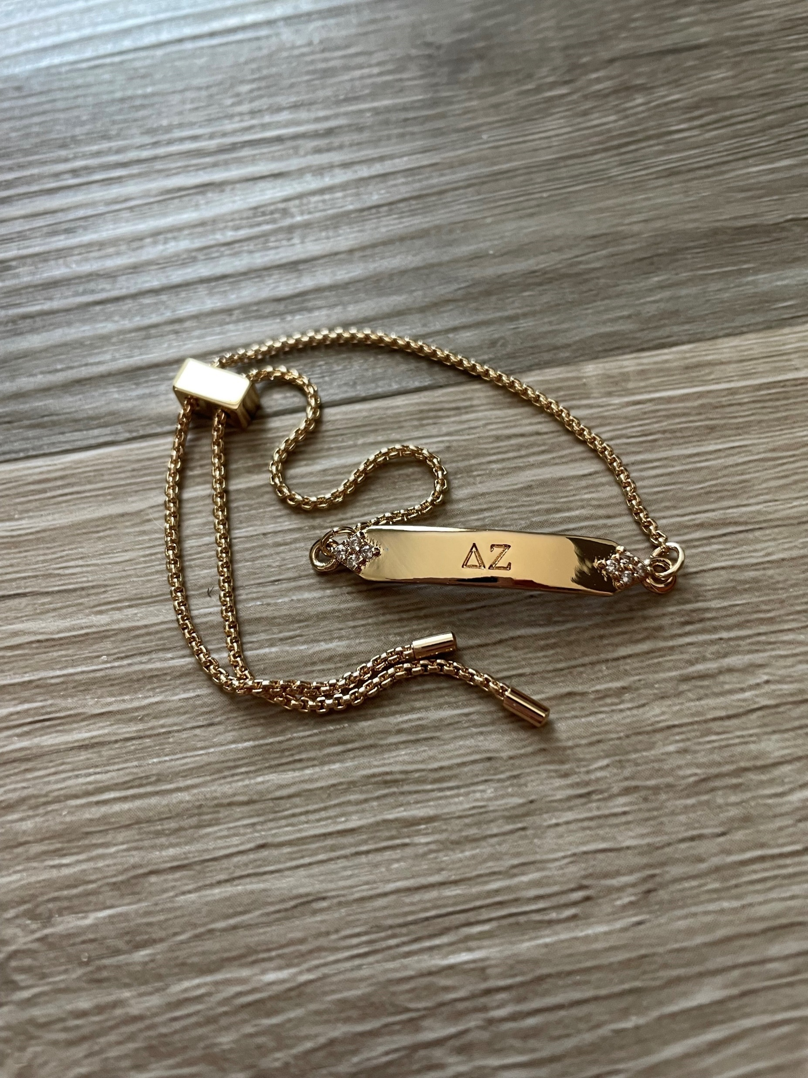
$750
$1,500

Slide 4
$3,000
Blanket

Slide 5
$5,000
Everyone who reaches this level will be entered to win 1 trip to a Delta Zeta event this spring!

